Slide 1
Deep Learning Basics
By
@JoeMayo
Code: https://github.com/JoeMayo/DeepLearningDemos

Slide 2
Overview
Why Deep Learning?
Background
Architecture
Forward Propagation
Cost Functions
Backward Propagation
Training and Testing
AI Ethics
Resources

Slide 3
Why Deep LearNing?
Categorization
Prediction
Image Recognition
Video Analysis
Natural Language Understanding (NLU)
Voice Recognition

Slide 4
Background
1940s – Various Connectionist Researchers (Warren McCulloch, Walter Pitts, Donald Hebb, et.al)
1957 – Perceptrons (Frank Rosenblatt)
1969 – Key Issues (Marvin Minsky and Seymour Papert)
1986 – Back Propagation (David Rumelhart, Geoffrey Hinton, and Ronald Williams)
Influenced by Yann LeCun
Mid to Late 1990s – Another cooling off period
2012 – AlexNet (Alex Krizhevsky, Geoffrey Hinton, and Ilya Sutskever)

Slide 5

Inspiration
Nucleus
Brain Cell
Axon
Axon
Terminals
Dendrites
Myelin Sheath

Slide 6
Artificial Neuron
z = w1*x1 + w2*x2 + b
Bias (b)
sigmoid(z) = 1/(1+e**-z)
x1
Weight (w1)
z
Sigmoid(z)
Output (y_pred)
x2
Weight (w2)

Slide 7
Neuron Implementation
Matrix Multiplication
z = w1*x1 + w2*x2 + b
W1 | w2
*
x1
x2
+
b
or
2 | 3
*
4
5
+
6
z = 2*4 + 3*5 + 6 = 29

Slide 8
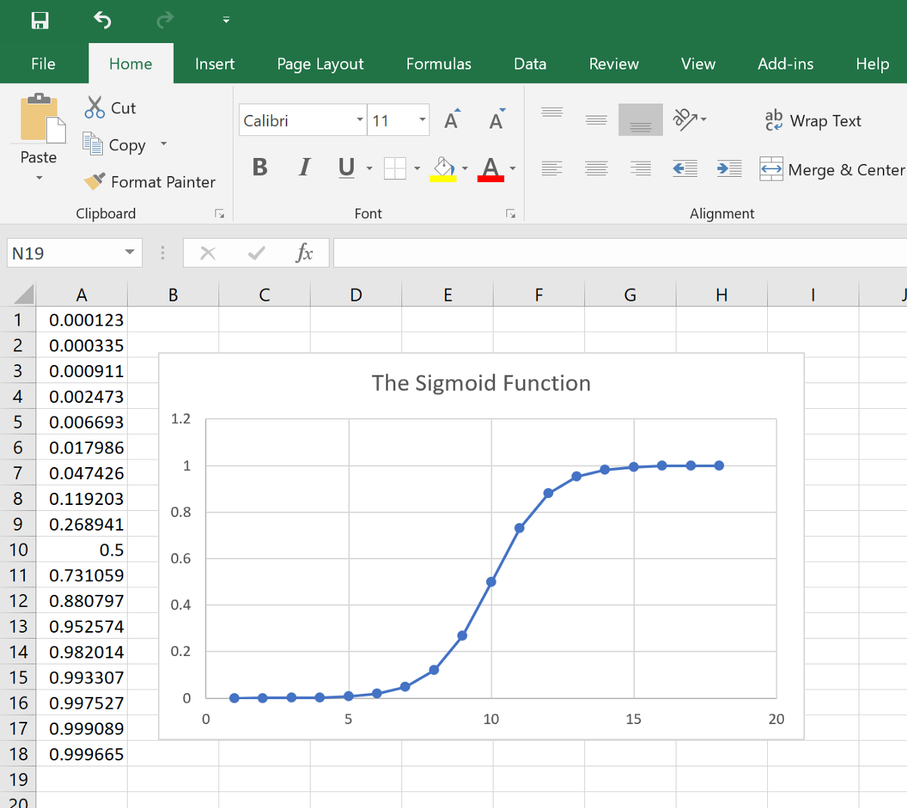
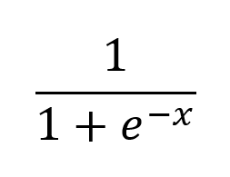
Neuron Implementation
Activation

Slide 9
Neural Net Architecture
Input
Layer 1 (hidden)
Layer 2 (hidden)
Layer 3 (hidden)
Layer 4 (output)
b1
a1
b1
x1
w1
c1
w2
w3
a2
b2
o
w4
c2
x2
w5
w6
a3
b3

Slide 10
Learning
1) Forward
x1
2) Calc
Loss
x2
3) Backward

Slide 11
Demo Program Description
Teaching the XOR Function
Two inputs
Treat value >= .5 as 1 else 0
.123 ^ .234 = 0 ^ 0 = 0
.345 ^ .678 = 0 ^ 1 = 1
.567 ^ .890 = 1 ^ 1 = 0
.789 ^ .012 = 1 ^ 0 = 1

Slide 12
Demo
Training and Testing Data

Slide 13
XOR Architecture
x1
x2

Slide 14
Forward Propagation
For each layer (from first to last):
Multiply weights with inputs and add bias
Set of nodes with linear functions
Execute activation function on results
Add non-linearity to result
Layer 1:
W1.T * X + b1
Z1
tanh(Z1)
A1
Layer 2:
W2.T * A1 + b2
Z2
sigmoid(Z2)
A2

Slide 15
Matrix operations
W
X
A (layer-1)
n Weights/Sample
w11 | w12 | w… | w1n
w21
…
2m1
x1
x2
x…
xn
a1
a2
a…
an
m samples
*
or

Slide 16
Demo
Forward Propagation

Slide 17
Cost Function
Aka “Loss Function”
Critical to Training
Inputs:
Result of Forward Propagation (predicted label)
Expected Value (true label)
Determines how well the predicted label matched the actual label
Outputs a value used to train (or optimize) the network
The goal of training is to minimize (optimize) the output of the cost function

Slide 18
Demo
Cost Function

Slide 19
Backward Propagation
For each layer (from last to first)
Calculate parameter derivatives
Gradient descent optimization
Multiply that derivative with the learning rate and subtract that from the current weight
The learning rate determines how fast the network learns
from cross_entropy()
from sigmoid()
Layer2:
dZ2
Y-A
a(1-a)
da
-y/a + (1-y)/(1-a)
L(a, Y)
dW2
A1*dZ2
and
db2
dZ2
Layer1:
dZ1
(W2 * dZ2) * (1-A1**2)
from tanh()
dW1
X*dZ1
and
db1
dZ1

Slide 20
Gradient Descent
For each parameter
New gradient helps
adjust parameter
Calculate derivative at point
For adjustment gradient
Searching for minima

Slide 21
Demo
Backward Propagation

Slide 22
Training and Testing
Stop iterating at
a specified number of epochs or
when the error from the cost function meets requirements
Tune Hyperparameters to Improve Results
Learning rate
Increase training set size
Add layers
Change nodes in layers
Other hyperparameters/techniques out of scope for this presentation: parameter initialization, regularization, momentum, optimizers, activation functions, data augmentation, feature engineering, and more.

Slide 23
Learning Rate
Good Learning Rate
High Learning Rate
Note: a learning rate that is too small slows down training

Slide 24
Demo
Hyperparameter Intro

Slide 25
AI Ethics
This is an exciting technology with incredible potential to make our lives easier, but we need to be cognizant of all aspects of the solutions we build.
Privacy
Use of personal data without authorization
Video surveillance and facial recognition in public
Bias in Data
Inappropriate use of protected status info (race, religion, age, …)
Non-Inclusive data – solution only works for a certain group of people
Weaponization
Military (robots, drones, intelligent weapons, …)
Politics (mass manipulation of targeted demographic groups)

Slide 26
Resources
Joe Mayo:
Email: jmayo@mayosoftware.com
Twitter: @JoeMayo
Code: https://github.com/JoeMayo/DeepLearningDemos
Andrew Ng’s Deep Learning Course on Coursera - https://www.deeplearning.ai
Microsoft Professional Program AI Track on EdX - https://academy.microsoft.com/en-us/professional-program/tracks/artificial-intelligence/
Udemy.com and Udacity.com also have AI courses
Deep Learning Framework Comparison on Wikipedia - https://en.wikipedia.org/wiki/Comparison_of_deep_learning_software
Khan Academy - https://www.khanacademy.org/

